Slide 1
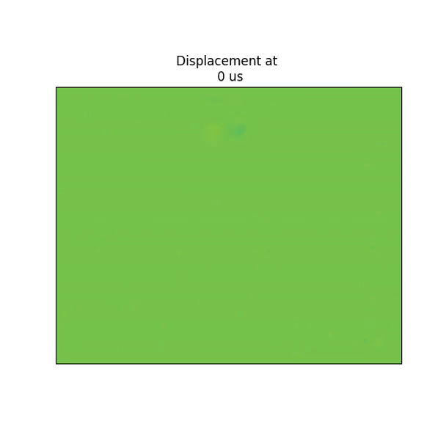


impact source
ground truth displacement
(measured using a scanning LDV
and many repeated knocks)
Notes:
In this paper<click> , we focus on imaging and extracting information from transient surface vibrations.

Slide 2
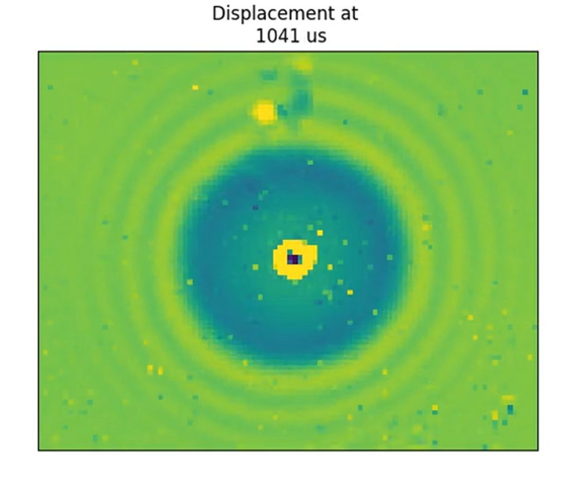

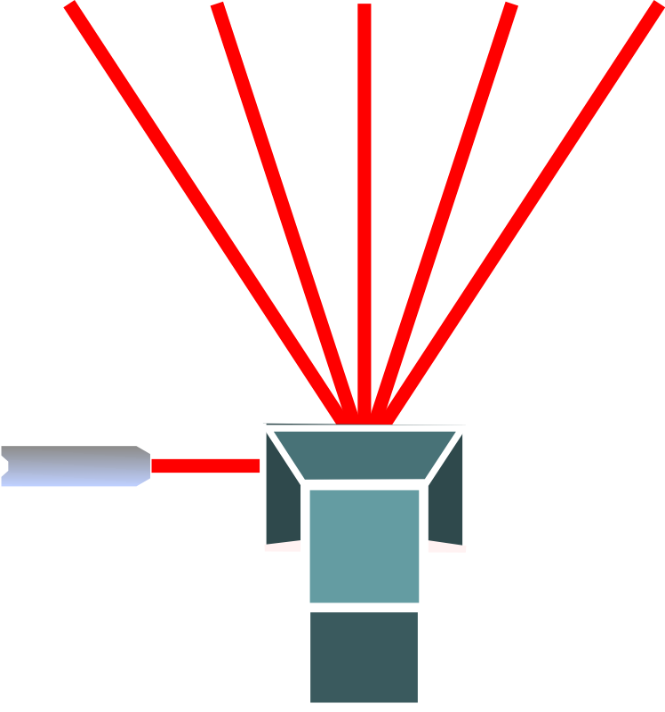
Elastic wave propagation
impact source
measurement points
elastic wave
laser
Notes:
We demonstrate that there exists a brief time interval immediately following the impact, during which the surface vibrations can be described<click> as an elastic wave that is propagating outward.

Slide 3

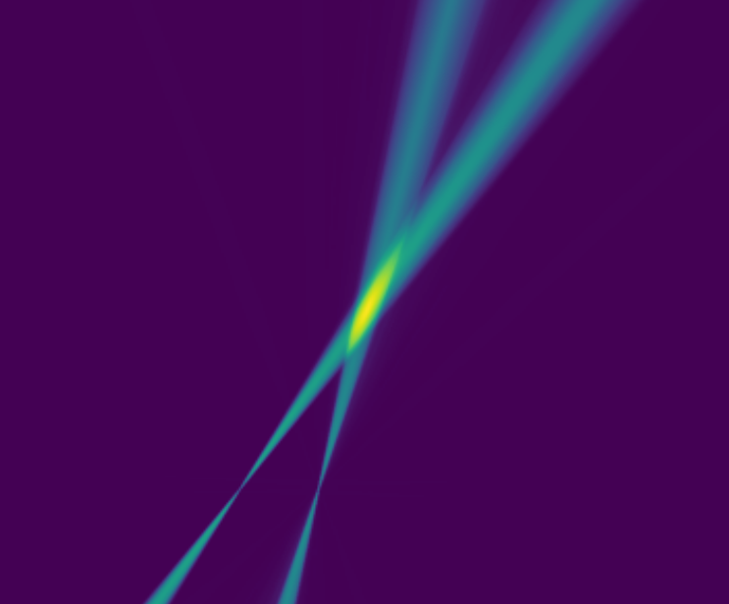
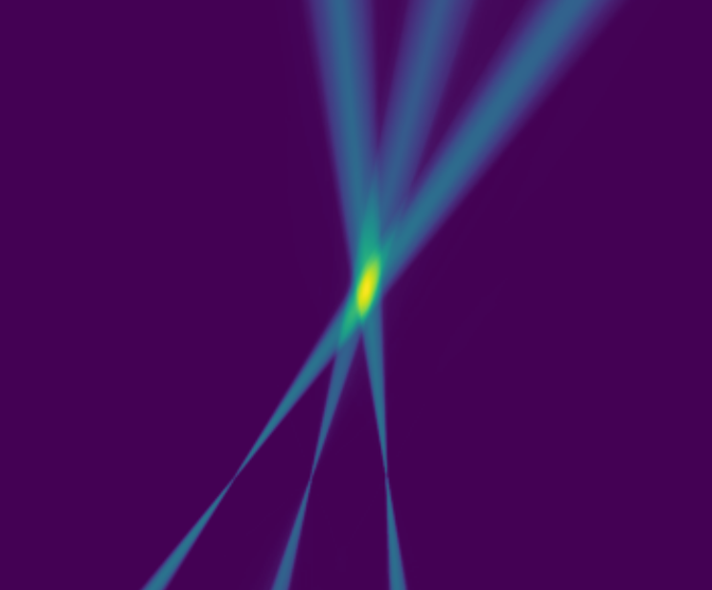
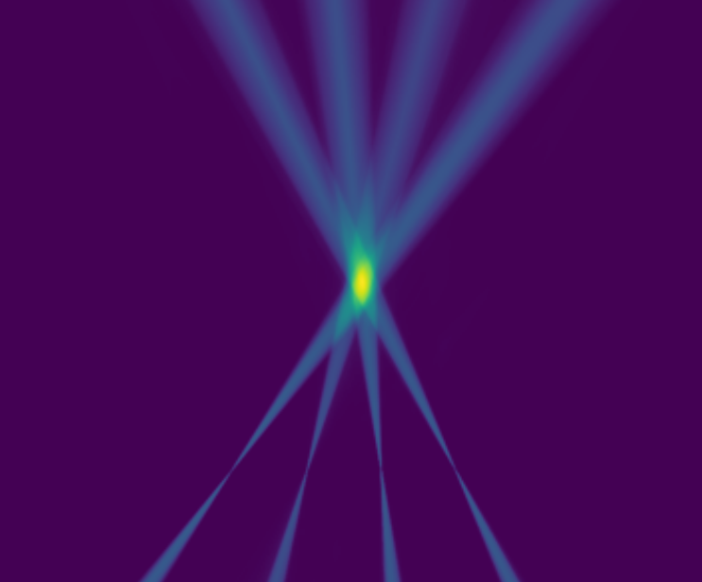
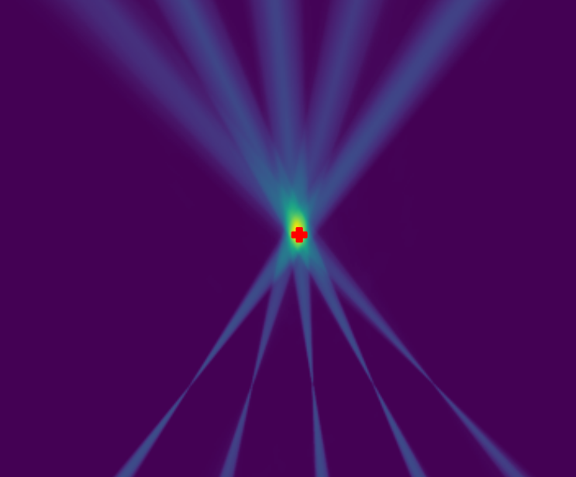
Localization with backprojection
Notes:
and develop a backprojection-based algorithm to <click>localize the impact sources using the vibrations within this time interval.

Slide 4
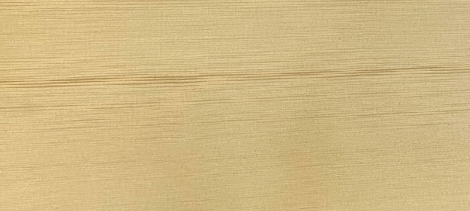
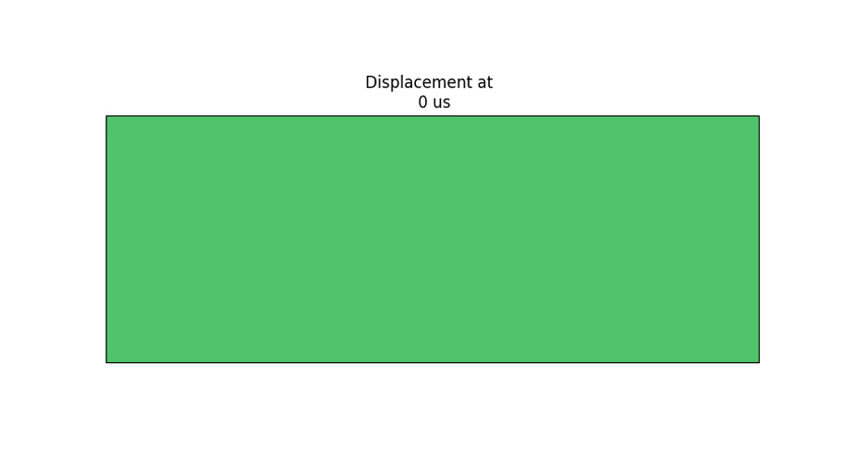
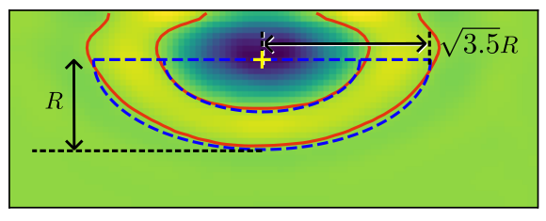
impact source
Orthotropic woodboard
Approximately elliptical wavefront

Slide 5
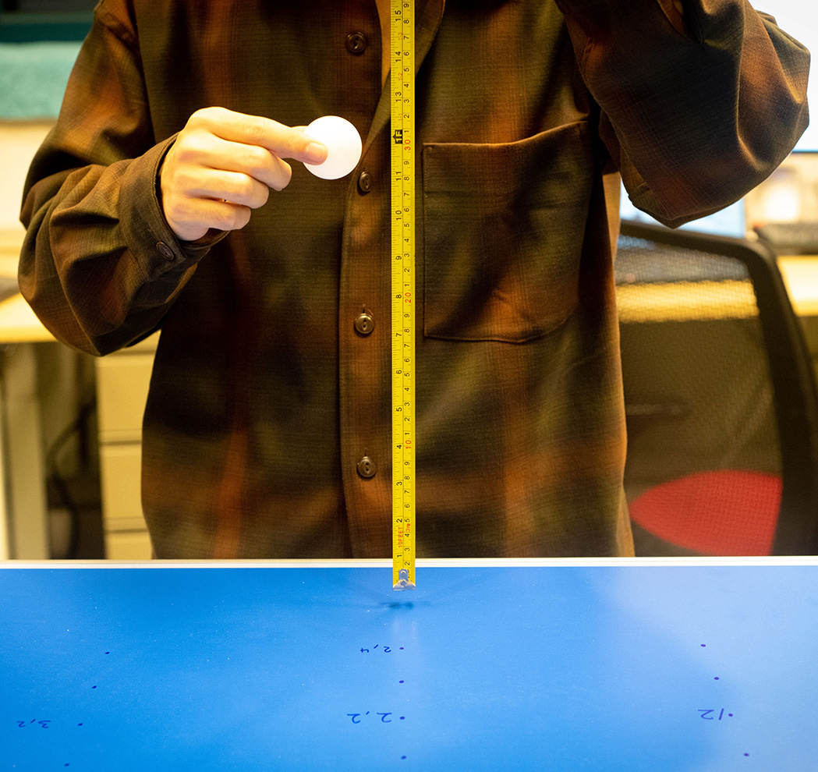
square root fit
magn. [px]
height [cm]

Slide 6
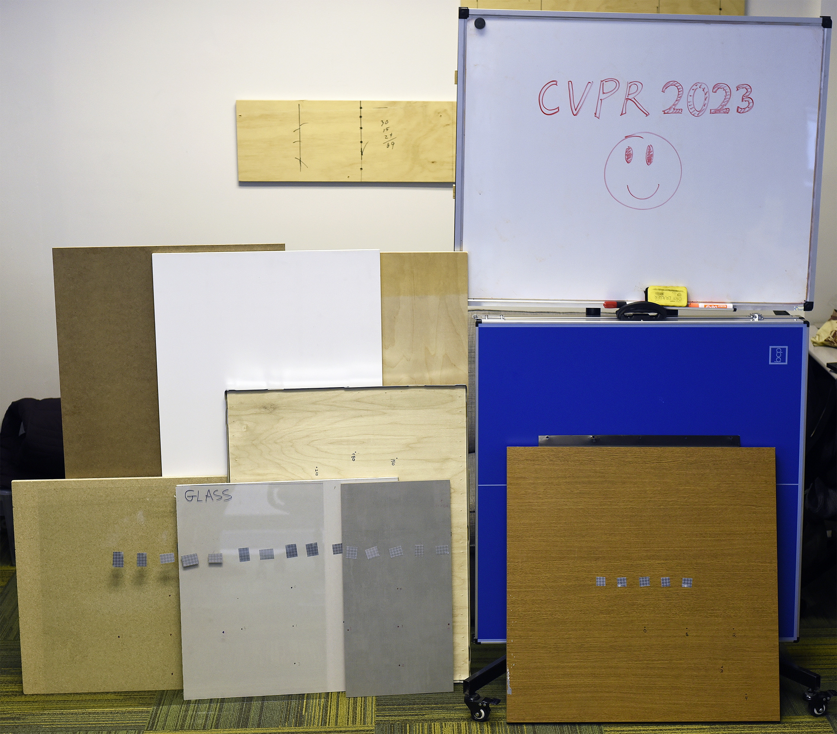
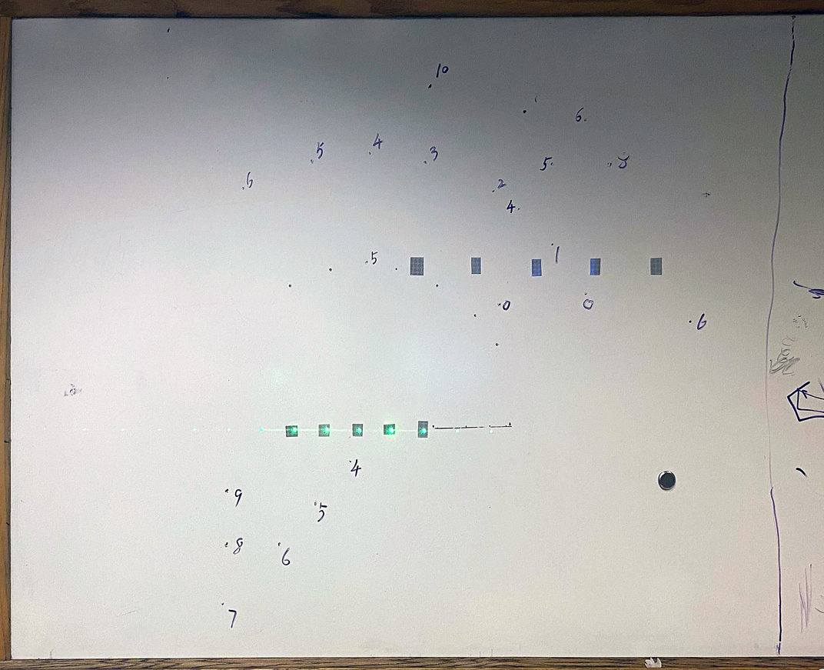
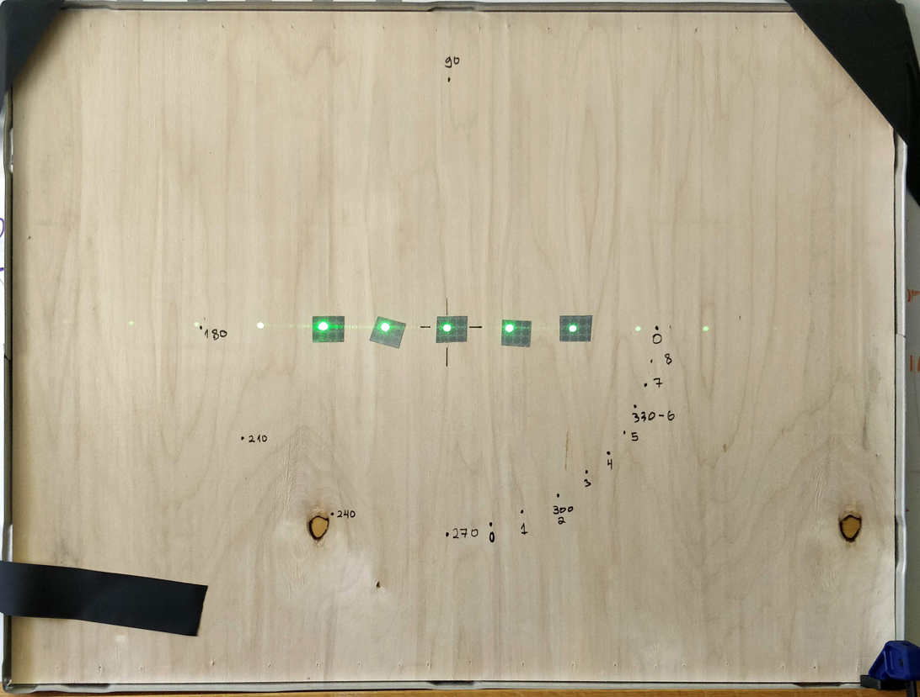
whiteboard (isotropic)
plywood (orthotropic)
whiteboard
birch
fiberboard
PVC panel
ping pong table
plywood 1
glass
plywood 2
particle
board
porcelain
gypsum
Notes:
We tested impact localization on various<click> isotropic and anisotropic materials.
For example <click>, here we show the localization for an isotropic whiteboard and an anisotropic plate of plywood.
For both materials,<click> we measure the vibrations using at five surface points, and knock <click> on points having different angles
on the same radious from the center points.
For each point<click>, we knock several times and recover the knocking position.

Slide 7

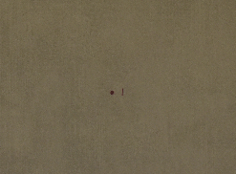

particleboard
porcelain
PVC panel

Slide 8
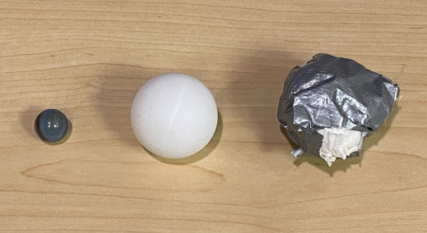
*normalized amplitude
5
y-tilts [px]
0
-5
time [ms]
0
10

Slide 9
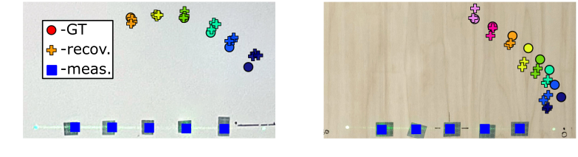
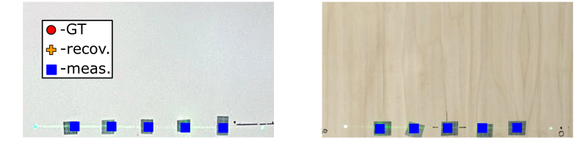
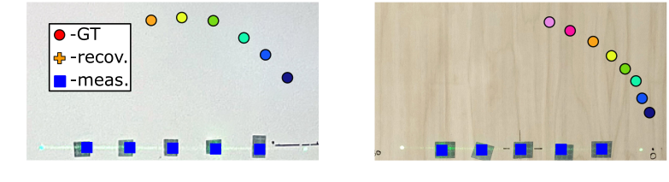
Testing localization on various materials
whiteboard (isotropic)
plywood (anisotropic)
whiteboard
birch
fiberboard
PVC panel
ping pong table
plywood 1
glass
plywood 2
particle
board
porcelain
gypsum
see paper and supplementary
for more material results
Notes:
We tested impact localization on various<click> isotropic and anisotropic materials.
For example <click>, here we show the localization for an isotropic whiteboard and an anisotropic plate of plywood.
For both materials,<click> we measure the vibrations using at five surface points, and knock <click> on points having different angles
on the same radious from the center points.
For each point<click>, we knock several times and recover the knocking position.

Slide 10
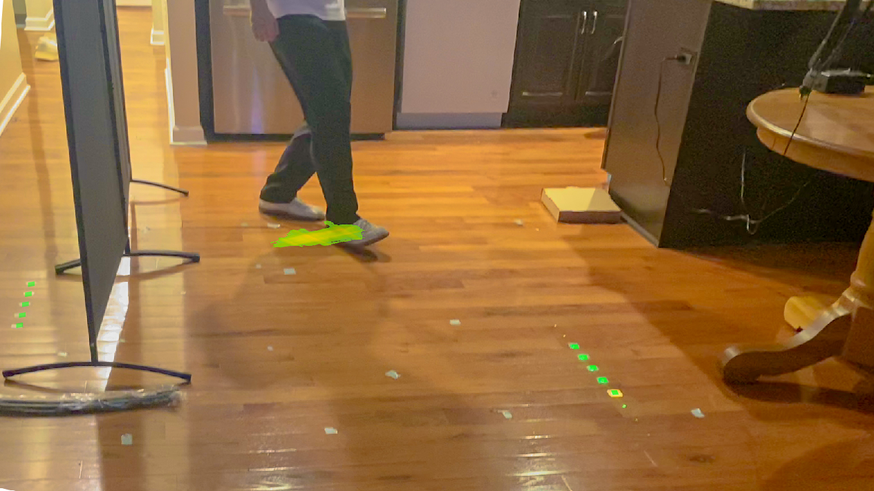
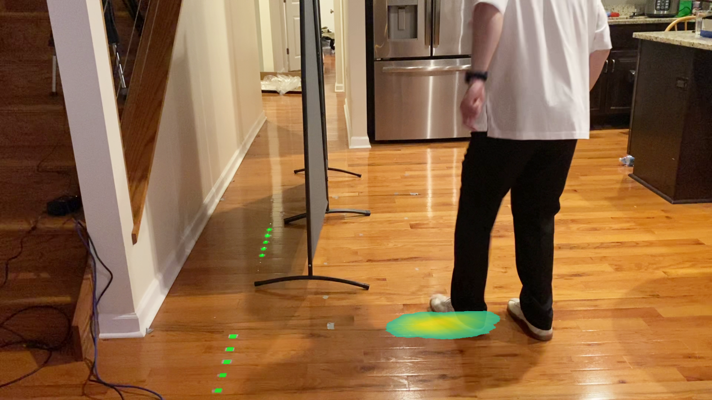
Localizing footsteps using vibrations
synthesized results having 10 markers
Notes:
Nevertheless, we show that using <click> more markers in non-colinear configurations significantly improves localizion.
Because our current prototype is unable to measure more than five colinear point, these results are synthesized by stepping at the same location twice and changing the camera’s measurement position.

Slide 11
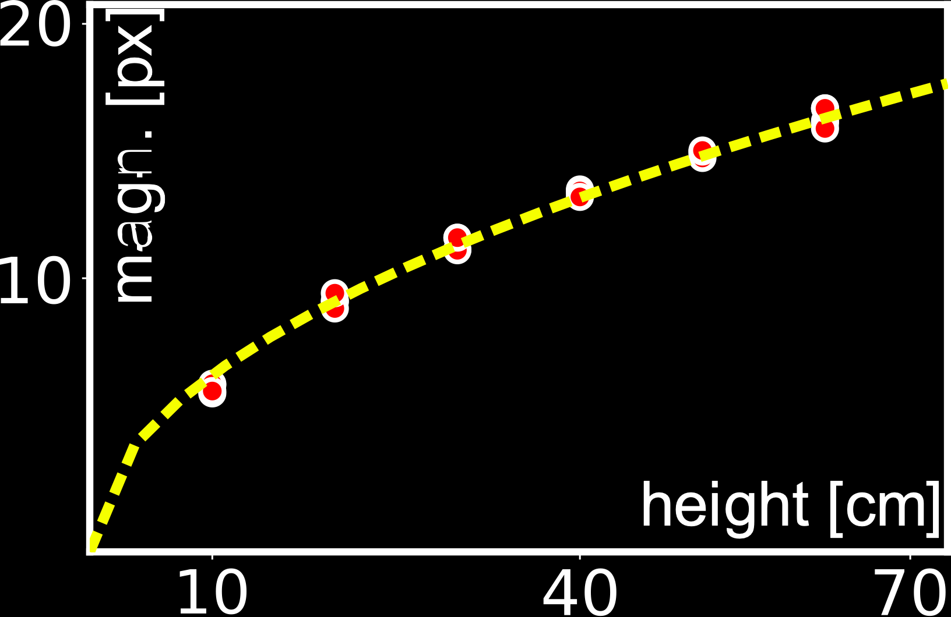
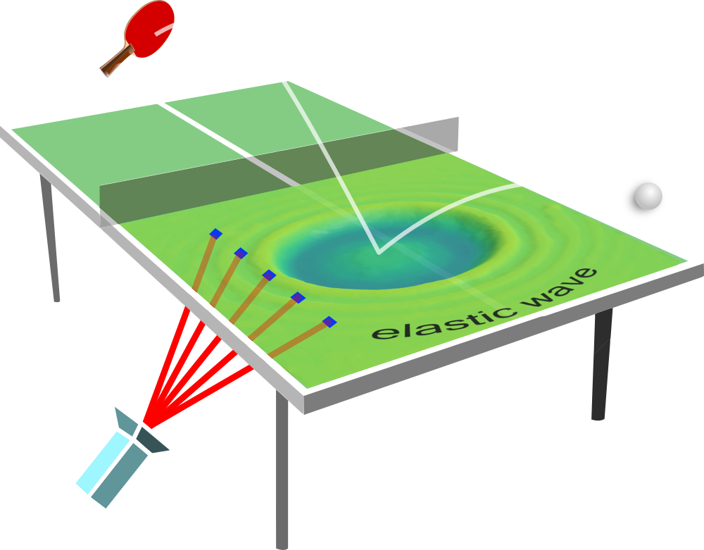

Towards inferring impact force & object shape
impact
force
impacting
object
correlating vibration magnitude to impact force
*normalized amplitude
object shape and stiffness effect on vibrations
Notes:
Moreover, the shape and composition of the dropped object, affects the spectral composition of the resulting vibrations.
For instance, dropping a soft object <click> creates smooth low-frequency vibrations, while dropping ever harder <click>objects, yields responses having higher-frequency components.

